Slide 1

Exoplanet Detection AI System
Team Voyagerss | NASA Space Apps Challenge 2025
Challenge: A World Away – Hunting for Exoplanets with AI
"AI for discovering new worlds beyond our solar system."
Our Mission
Team
Democratizing exoplanet discovery through advanced machine learning, making NASA's wealth of space data accessible to researchers, educators, and space enthusiasts worldwide.
Dhruvil Satani
Dharmik Kakadiya
Niharika
Anjali Dhanani

Slide 2

Exploring the Universe Through AI
The Exoplanet Detection AI System is an advanced machine learning platform that identifies and classifies exoplanets using NASA's Kepler, K2, and TESS mission data with unprecedented precision.
By integrating cutting-edge astrophysics principles with modern data science techniques, our system distinguishes between confirmed exoplanets, planetary candidates, and false positives with remarkable 95.2% accuracy.
Advanced Detection
Intelligent Classification
Multi-mission data integration from NASA's premier space telescopes
Ensemble ML algorithms for reliable exoplanet identification
Democratic Access
User-friendly tools for global research and education communities

Slide 3




From Data to Discovery: How the System Works
Data Pipeline
ML Models
Real-time API integration from NASA Exoplanet Archive with automated quality validation, missing value imputation, and comprehensive normalization protocols.
Sophisticated ensemble algorithms, including Random Forest, XGBoost, LightGBM, and Neural Networks, with automated hyperparameter tuning and rigorous k-fold cross-validation.
Web Interface
Flask-based interactive dashboard featuring real-time prediction capabilities, batch processing for large datasets, and comprehensive visualization tools.
Our modular architecture ensures scalability, maintainability, and seamless integration with NASA's expanding mission data repositories.

Slide 4

Powered by NASA Mission Data
Our system leverages decades of groundbreaking space telescope observations, transforming raw astronomical data into actionable exoplanet discoveries.
Kepler Mission (2009–2017)
TESS All-Sky Survey (2018–present)
150,000+ stars observed
Bright nearby stars, ongoing discoveries
Revolutionary transit photometry established the foundation for modern exoplanet detection, contributing over 2,600 confirmed exoplanets to our training dataset.
Comprehensive all-sky monitoring delivers continuous data streams, enabling real-time model updates and validation against the latest astronomical discoveries.
1
2
3
K2 Extended Mission (2014–2018)
19 campaigns, 500+ new planets
Expanded observational capabilities across the ecliptic plane, providing diverse stellar environments and planetary system architectures for enhanced model robustness.
Data sourced from NASA Exoplanet Archive and official mission repositories.

Slide 5
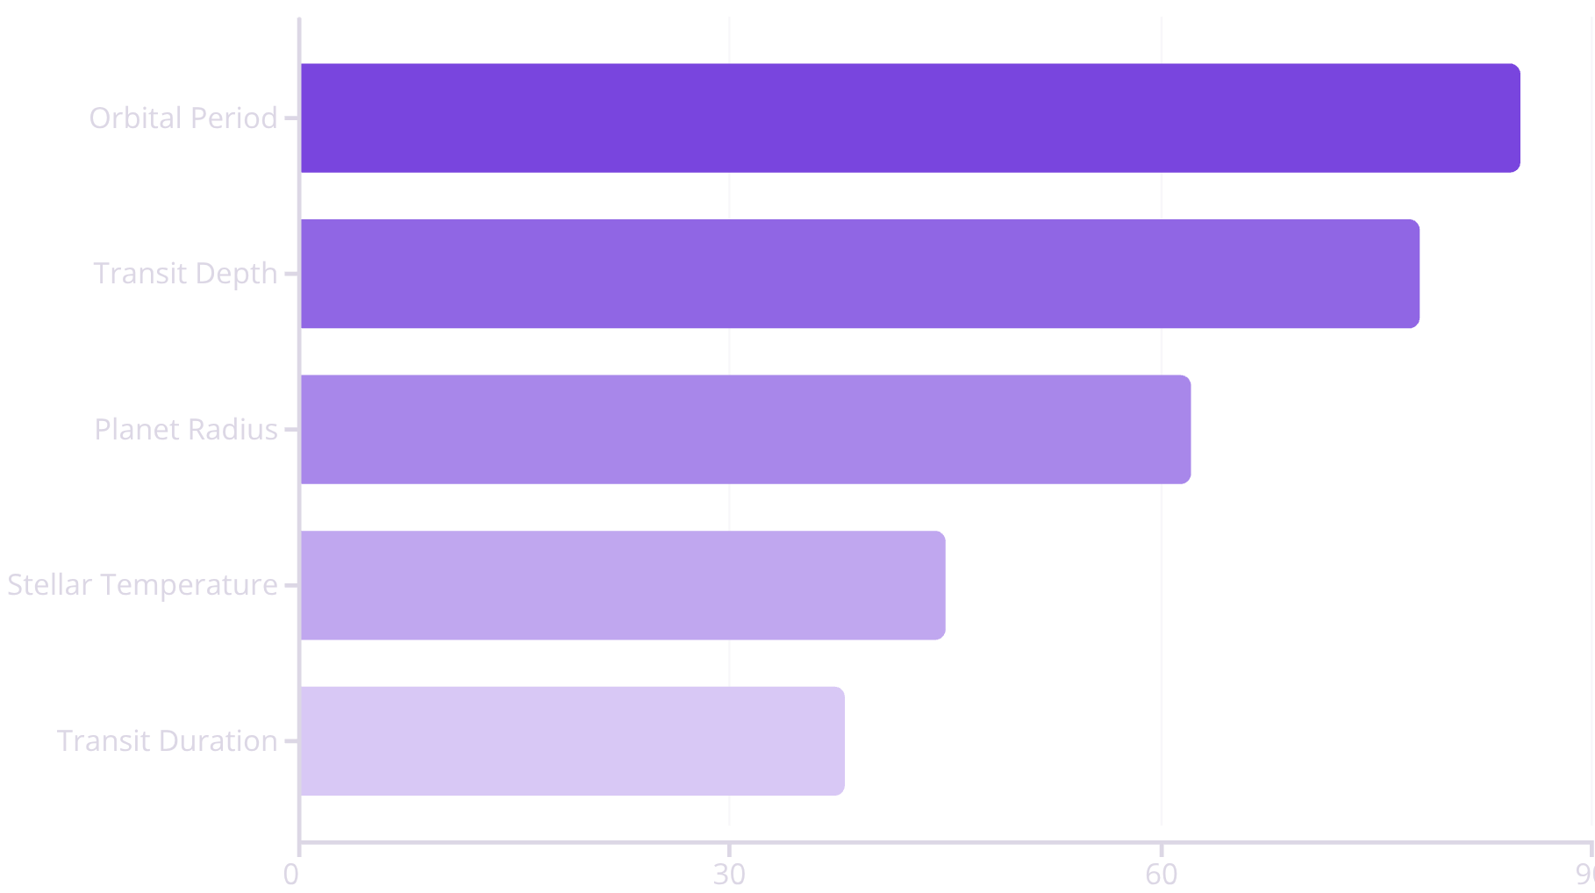
Performance Metrics & Core Capabilities
Model Performance
Feature Importance Analysis
Metric
Value
Accuracy
95.2%
Precision
92.8%
Recall
91.5%
F1-Score
92.1%
Ensemble learning architecture ensures both reliability and interpretability in exoplanet classification decisions.

Slide 6
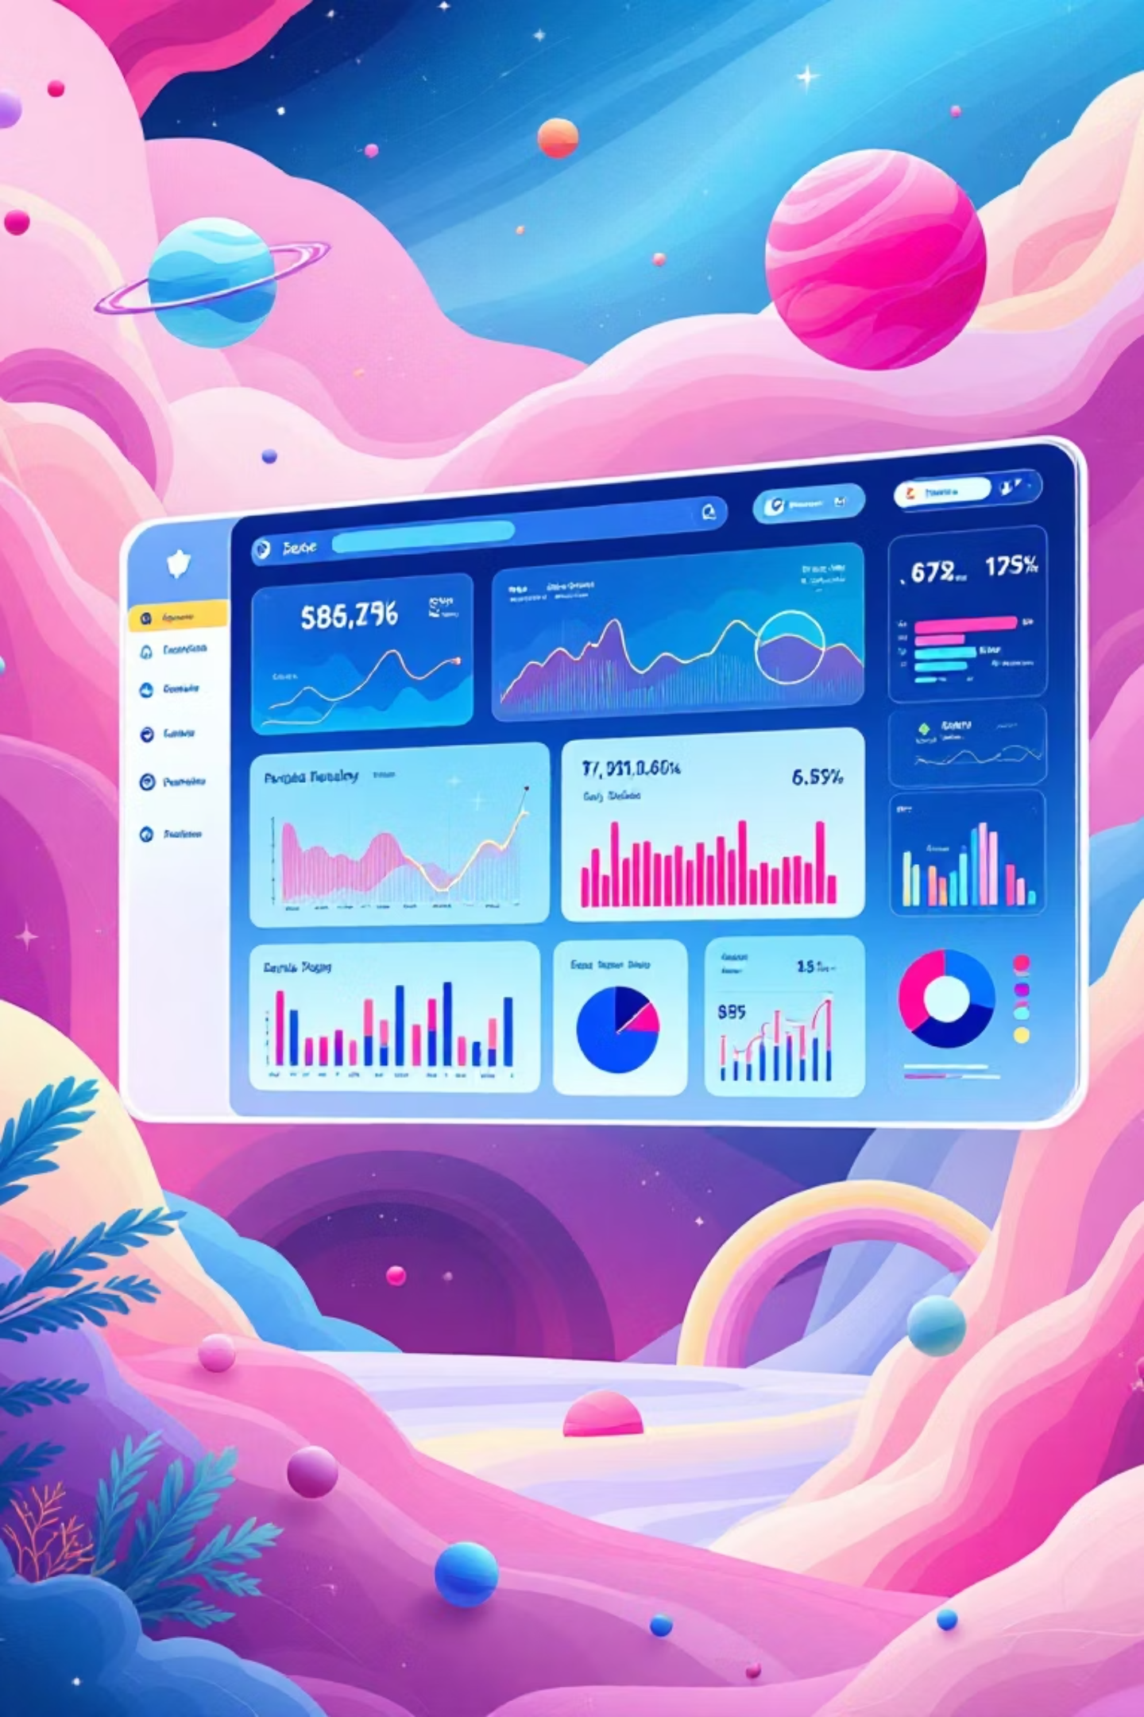








Hands-on AI Exploration for Astronomers
Our interactive web interface bridges the gap between complex machine learning algorithms and practical astronomical research, making advanced exoplanet detection accessible to users across all experience levels.
Single Prediction
Manual parameter entry for individual planetary systems with real-time classification results and confidence intervals.
Batch Processing
CSV-based bulk classification for large datasets, enabling efficient analysis of extensive observational catalogs.
Visualization Dashboard
Interactive exploration of mission data, class distributions, statistical trends, and discovery timelines.
Adaptive Learning
Model retraining capabilities based on new inputs and validated discoveries, ensuring continuous improvement.
"Empowering discovery through real-time analysis and intuitive visualization tools designed for the modern astronomer."

Slide 7




Expanding the Frontier of Space Discovery
Current Impact
Future Enhancements
Accelerates exoplanet classification and discovery workflows
Integration with JWST and upcoming NASA missions
Makes NASA's vast open data archives globally accessible
Unsupervised anomaly detection for rare planetary types
Promotes STEM engagement through citizen science initiatives
Deployment on NASA's Open Science Cloud platform
Supports next-generation astronomical research
Enhanced machine learning for atmospheric characterization
NASA Exoplanet Archive
Kepler, K2, TESS Teams
Open-Source Communities
"AI is the telescope of the digital age — revealing the unseen worlds that await discovery."

